Slide 1

CNN-SLAM:
Real-time dense monocular SLAM with learned depth prediction
Keisuke Tateno, Federico Tombari, Iro Laina, Nassir Navab

Slide 2
OUTLINE
Overview
Goal
Related work
Proposed Method
Evaluation
Conclusion

Slide 3
Overview/Goal
Main idea: Exploit best from both worlds
Convolutional Neural Network for depth prediction
Direct feature-less monocular SLAM
Goal: Improve performance of SLAM by using CNN depth prediction
Limitations of previous work with SLAM
Pose estimation under pure rotational camera motion
Absolute scale
Dense depth maps along texture-less regions

Slide 4
Related Work
SLAM
Type of input data: Depth camera or monocular
Methodological: Direct (feature-less) or feature-based
State of the art
ORB-SLAM, DTAM, LSD-SLAM, MLM
In this paper:
direct monocular SLAM approach, as proposed in LSD-SLAM: Large-Scale Direct Monocular SLAM Jakob Engel and Thomas Schöps and Daniel Cremers
Notes:
ORB
Oriented, Fast and Rotated Brief
DTAM
Dense Tracking and Mapping
MLM
Multi-level mapping
LSD-SLAm
Large-Scale Direct
allows to build large-scale, consistent maps of the environment
in real-time as pose-graph of keyframes with associated semi-dense depth maps

Slide 5
Related Work
Depth prediction from single view
Classic single view depth prediction usually makes strong scene geometry assumptions
Deep learning significantly outperforms classic methods
Accurate, even under absence of monocular cues
Absolute scale can be learned, even without scene-based assumptions or geometric constraints
Network based on Residual Network (ResNet)
Notes:
Monocular cues: texture, repetitive patterns
Classic depth prediction approaches employ hand-crafted features and probabilistic graphical models to yield regularized depth maps, usually making strong assumptions on the scene geometry

Slide 6
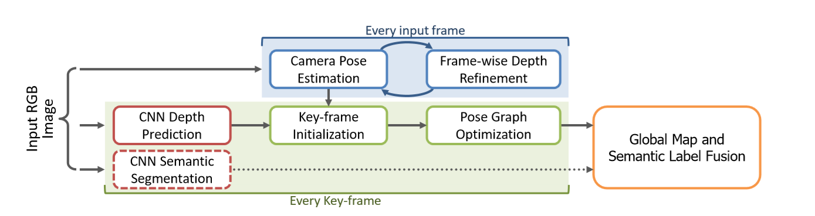
Proposed Method
Pipeline
Keisuke Tateno, Federico Tombari, Iro Laina, Nassir Navab. CNN-SLAM: Real-time
Dense monocular SLAM with learned depth prediction
Notes:
Depth map with CNN only on keyframes, higher framerate
Each keyframe is associated a pose, depth map and uncertainty map. Uncertainty map between near keyframes, pixel-wise conﬁdence of depth prediction. Used to propagate refinement of nearest CNN keyframe depth map.
[important] Frame-wise depth refinement: continuously reﬁne the CNN-predicted depth map associated to each key-frame via small-baseline stereo matching, by enforcing color consistency minimization between a key-frame and associated input frames.
Set of keyframes, whose pose is subject to global refinement based on pose graph optimization
New keyframe created if disparity large
Normalization to overcome different intrinsic camera parameters.
Camera pose estimation: at each frame, estimating transformation between the frame and nearest keyframe

Slide 7
Proposed Method
Fuse CNN-predicted depth map with direct monocular SLAM depth estimations
Hold set of visually distinct keyframes and refine pose based on pose graph optimization. Predict deep depth map only on key-frames.
Camera pose estimation on each input frame
Uncertainty map and normalization procedure of depth map
Notes:
To overcome slam limitations
Keyframes are visually distinct frames, whose pose is subject to global refinement based on pose graph optimization

Slide 8
Evaluation
Method has been compared against LSD-SLAM, ORB-SLAM and REMODE
Is able to outperform all methods
Proposed scheme effectively reﬁnes the blurred edges and wrongly estimated depth values predicted by the CNN
Notes:
REMODE: REgularized MOnocular Depth Estimation
Outperforms, even if on unseen environment

Slide 9
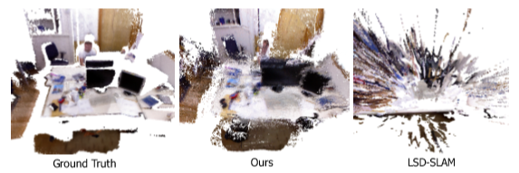
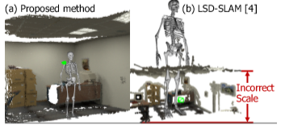
Evaluation
Pure rotational motion
Absolute scale
Notes:
REMODE: REgularized MOnocular Depth Estimation
Outperforms, even if on unseen environment

Slide 10
Conclusion
SLAM with depth prediction by using deep learning can overcome inherent limitations of previous monocular reconstruction methods
Future research in more refined depth prediction
Notes:
REMODE: REgularized MOnocular Depth Estimation

